Slide 1
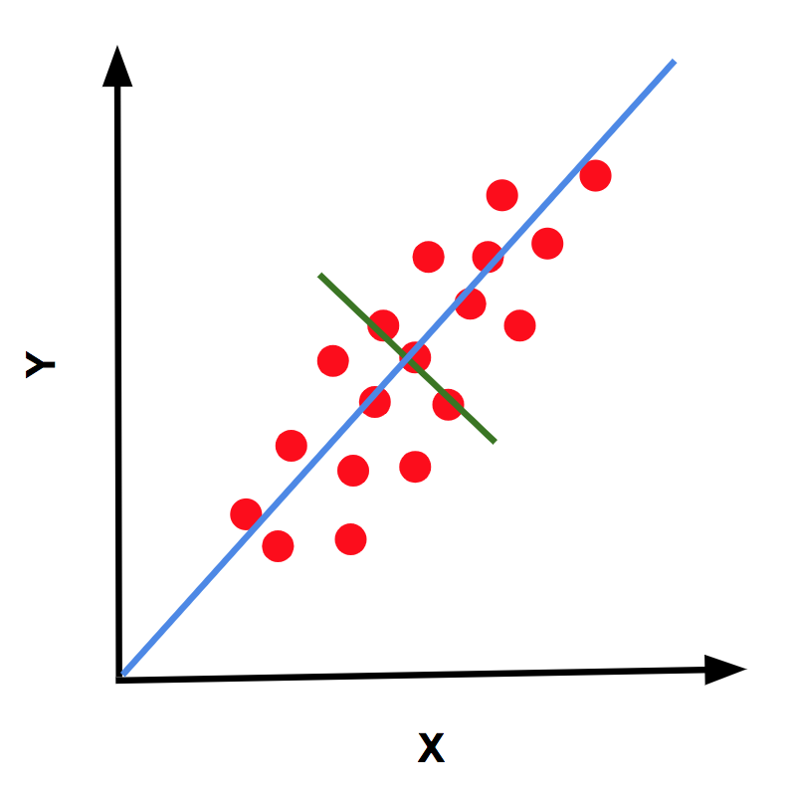
C4.5 Algorithm

Slide 2
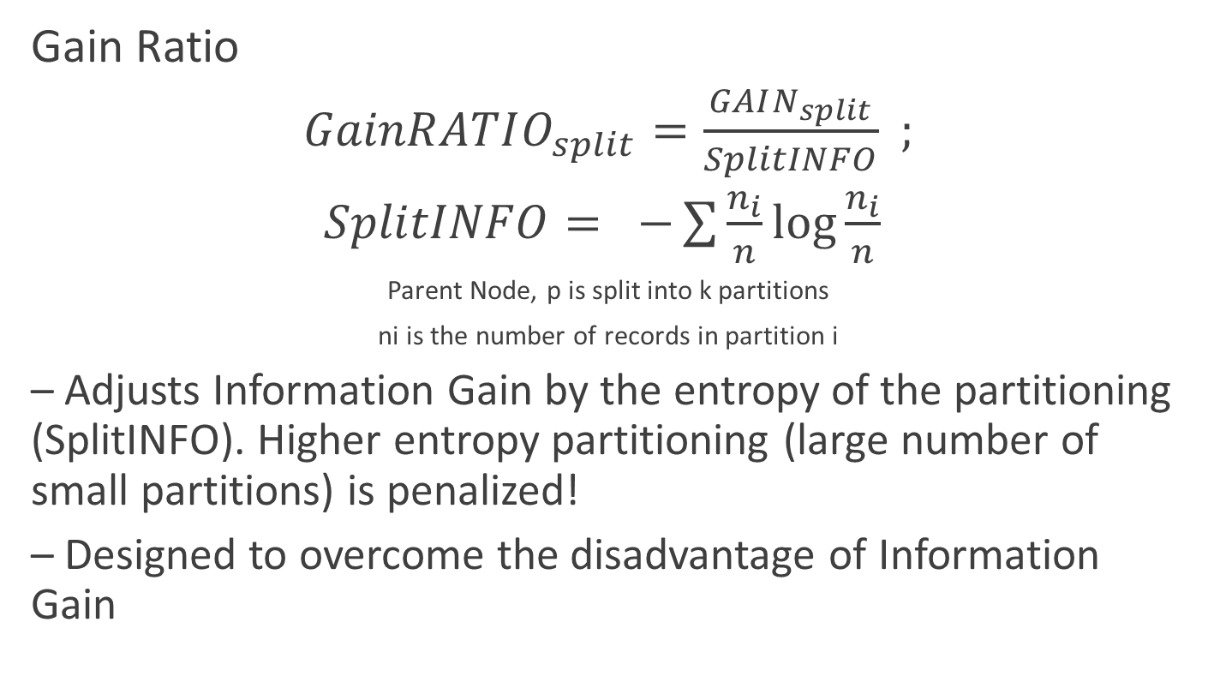
Splitting based on GainRATIO
Gain Ratio
$GainRATIO_{split}=\frac{GAIN_{split}}{SplitINFO}$ $;$
$SplitINFO= −\sum{\frac{n_{i}}{n}\log{\frac{n_{i}}{n} }}$
Parent Node, p is split into k partitions
ni is the number of records in partition i
– Adjusts Information Gain by the entropy of the partitioning (SplitINFO). Higher entropy partitioning (large number of small partitions) is penalized!
– Designed to overcome the disadvantage of Information Gain

Slide 3
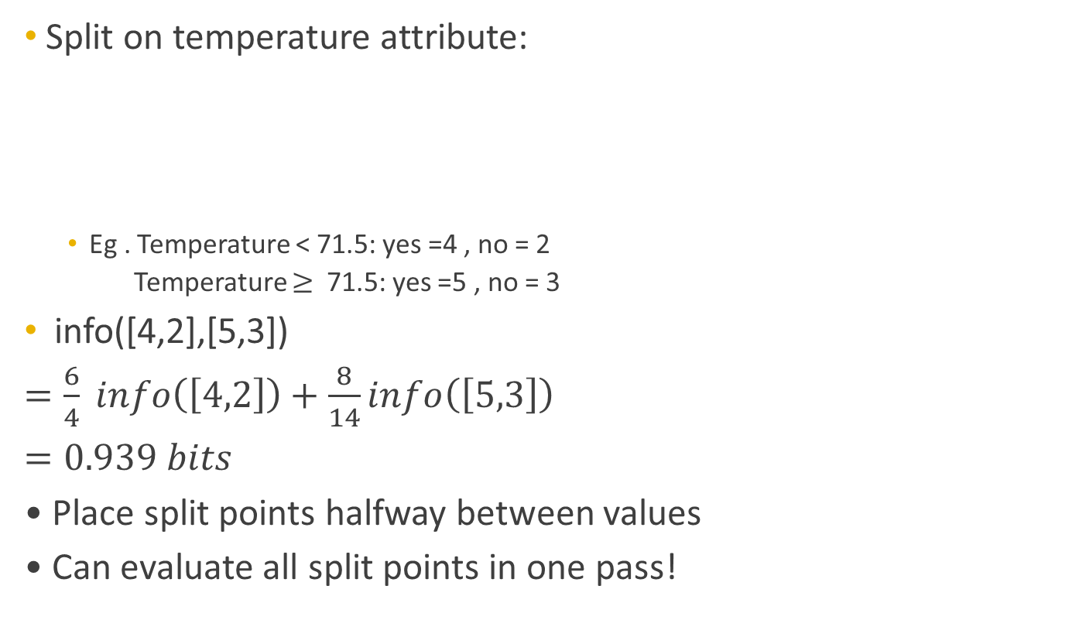
Handling Numeric Attribute
Split on temperature attribute:
Eg . Temperature < 71.5: yes =4 , no = 2
Temperature $≥$ 71.5: yes =5 , no = 3
info([4,2],[5,3])
$=\frac{6}{4} info\left(\left[4,2\right]\right)+\frac{8}{14}info\left(\left[5,3\right]\right)$
$=0.939 bits$
• Place split points halfway between values
• Can evaluate all split points in one pass!
65 | 65 | 68 | 69 | 70 | 71 | 72 | 72 | 75 | 75 | 80 | 81 | 83 | 85
YES | NO | YES | YES | YES | NO | NO | YES | YES | YES | NO | YES | YES | NO

Slide 4
Avoid repeated sorting
Sort instances by the values of the numeric attribute
Time complexity for sorting: O (n log n)
Q. Does this have to be repeated at each node of the tree?
• A: No! Sort order for children can be derived from sort order for parent
– Time complexity of derivation: O (n)
– Drawback: need to create and store an array of sorted indices for each numeric attribute

Slide 5
Handling Missing Values
• Missing value denoted “?” in C4.X
• Simple Idea: Treat missing as a separate value
• Q: When this is not appropriate?
• A: When values are missing due to different reasons
Example 2: Field IsPregnant=missing for a male patient should be treated differently (no) than for a female patient of age 25 (unknown)

Slide 6
Missing values – Advanced
• Split instances with missing values into pieces
– A piece going down a branch receives a weight proportional to the popularity of the branch
– Weights sum to 1
• Info gain works with fractional instances
– Use sums of weights instead of counts
• During classification, split the instance into pieces in the same way
– Merge probability distribution using weights

Slide 7
Reference

